Slide 1
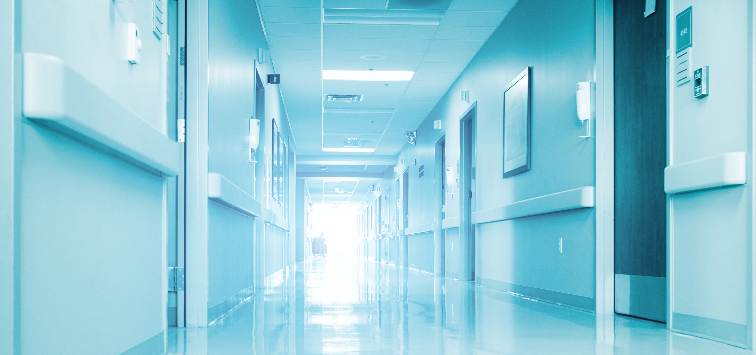
Rational Basis for Updating the Recommended Limit on Radiation Dose to the Public
Darrell R. Fisher
Pasco, Washington September 30-October 3, 2018 Joint Conference on Applicability of Radiation-Response Models to Low-Dose Protection Standards

Slide 2
Q: Should the public dose limit be 1 mSv/year or 5 mSv/year?
Or something else?

Slide 3
Historical Context (ICRP-26;1977)
The International Commission on Radiological Protection (ICRP) recommended a public dose limit of 5 mSv per year (effective dose equivalent) in Publication 26 (1977) (= 500 mrem/year whole-body)
…And an occupational dose limit of 50 mSv/year
for radiation workers

Slide 4
Historical Context (ICRP-26;1977)
“The assumption of a total risk on the order of 10⁻² Sv⁻¹ . . . would imply restriction of the lifetime dose to the individual member of the public to a value that would correspond to 1 mSv per year of life-long whole body exposure. . .”
“The Commission’s recommended limit of 5 mSv (0.5 rem) in a year . . . has been found to provide this degree of safety, and the Commission recommends its continued use . . .” (para. 119)

Slide 5
Historical Context (ICRP-26;1977)
Explained Further:
“The application of an annual dose-equivalent limit of 5 mSv to individual members of the public is likely to result in average dose equivalents of less than 0.5 mSv.”
(ICRP-26, para. 120)
1/10th

Slide 6
Historical Context (1983 Washington Meeting)
“For stochastic effects in members of the public, the Commission recommends that the committed effective dose equivalent from exposure to radioactive materials in any year be limited to 5 mSv, and, for repeated exposure [to radioactive materials] over prolonged periods, that it would be prudent further to restrict this to 1 mSv from each year of lifelong exposure.”
(ICRP Statement,1983 Washington DC Meeting)

Slide 7
Historical Context (1985 Paris Statement)
In the Paris Statement from its 1985 meeting (Publication 45), the ICRP revised downward the public dose limit to 1 mSv, with one caveat:
“However, it is permissible to use a subsidiary dose limit of 5 mSv in a year for some years, provided that the average annual effective dose equivalent over a lifetime does not exceed the principal limit of 1 mSv in a year.”
(ICRP-45; 1985)

Slide 8
Historical Context (ICRP-60, 1991)
When the ICRP lowered its recommended occupational exposure limit from 50 mSv/year to 20 mSv/year, it also reduced its recommended dose limit for members of the public from 5 mSv to 1 mSv.
(Table 6, para. 194)

Slide 9

Historical Context (ICRP-60, 1991)
ICRP justified this change on the basis that “the annual effective dose from natural sources is about 1 mSv” (para. 191) and that “this natural background may not be harmless”.
(para. 190)

Slide 10
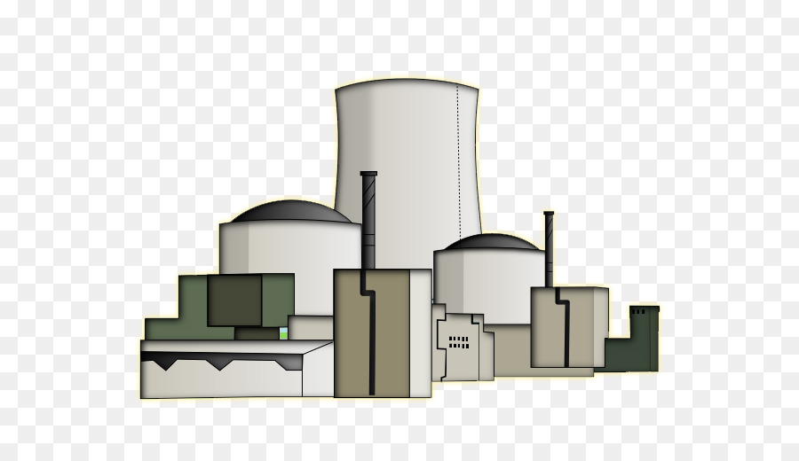
Historical Context (ICRP-60, 1991)
“It is implicit in this limit that the constraints for the optimization of protection in the design of new installations should be smaller than 1 mSv in a year.”
(para. 192)

Slide 11
Essential Underlying Assumptions for a 1 mSv limit
Future radiation-induced cancer incidence is predictable
Risk of stochastic detriment from low-level, low-dose-rate radiation is known, and in all cases may be modeled correctly from the Japanese atomic bomb survivor Life Span Study epidemiology
The linear, no-threshold dose-response (LNT) hypothesis holds at all dose levels between 0 and 100 mSv
The additive risk hypothesis holds for lifetime exposure
Risk-modifying factors (dose rate, cellular repair, sex, age at exposure, smoking, and diet) and all known molecular biologic response mechanisms are irrelevant and have no influence on underlying cancer risk for all types of cancer

Slide 12
Multiple Sources of Public Exposure
Another factor driving the ICRP public dose limit downward to 1 mSv per year was the idea that the public could be exposed to more than one “planned exposure,” such as a nuclear power plant and a DOE clean-up site

Slide 13
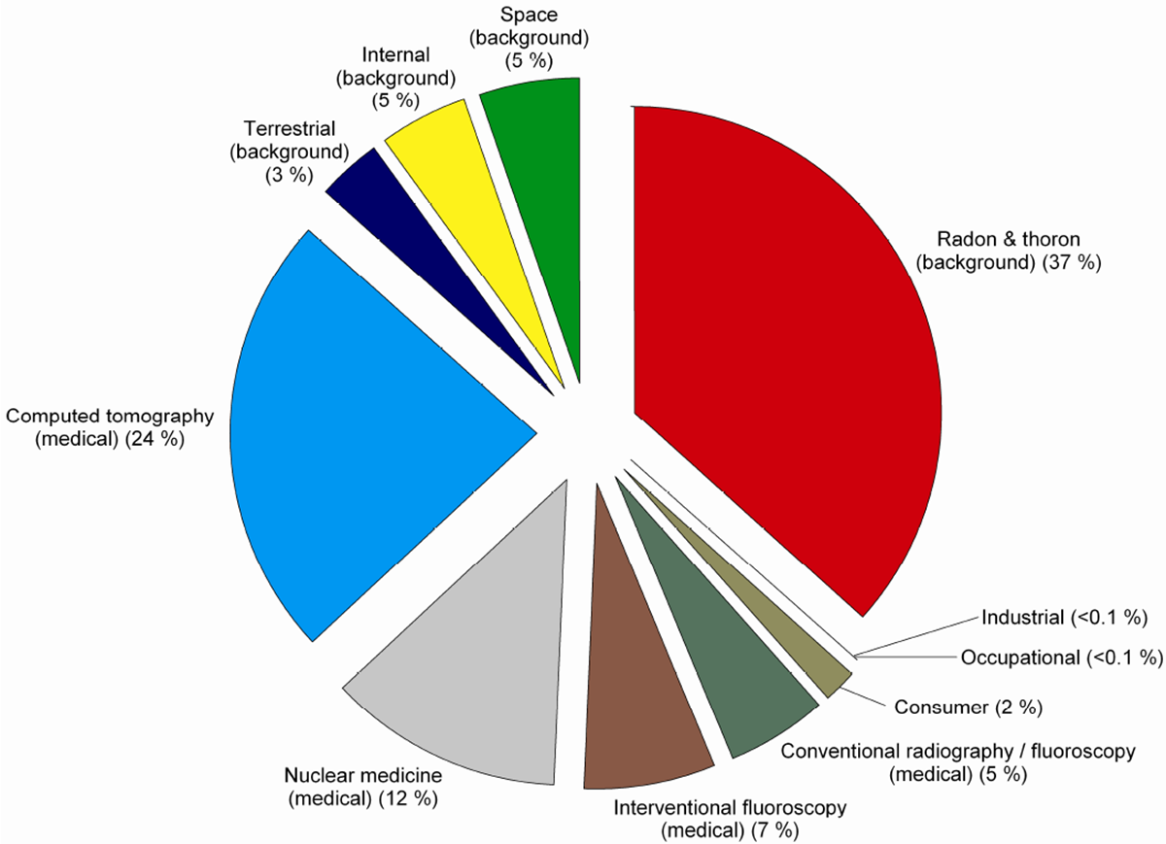
NCRP Report No. 160, “Ionizing Radiation Exposure of the Population of the United States” (2009)
“nuclear”
Average annual background in the U.S. is 6.2 mSv = 620 mrem/year

Slide 14
What is 1 millisievert Effective Dose?
The unit effective dose is mathematical construct of “risk” and not a physical quantity of “dose” . . .*
. . . doubly weighted for committee-selected (arbitrary) radiation quality multipliers and tissue weighting factors (and wr for alphas should not be 20)
1 mSv is assumed equal to the whole-body dose that one might receive from a continuous ambient external exposure rate of about 100 mrem/year (about 11 µR/hour)
…or about 1/6th of the average annual dose from natural background, including indoor radon and medical sources
*Health Phys. 2017 Aug;113(2):102-109

Slide 15
What is the Perceived Risk of 1 mSv Per Year?
If the linear, no-threshold dose-response hypothesis were correct, and if the risk coefficient at low dose is 5%/Sv, then conservatively:
The perceived lifetime risk at 1 mSv represents:
0.05 Sv⁻¹ y⁻¹ x 0.001 Sv x 70 years = 0.0035 = 0.35% additive risk on top of a natural cancer risk of about 40% in the general population
= 40% + 0.35% = 40.35%

Slide 16
On Closer Analysis…
The ICRP rationale for lowering the public dose limit from 5 mSv to 1 mSv per year looks weak because it was not based on citable science
No evidence has been presented or referenced during the past 35 years that lowering the public dose limit from 5 mSv to 1 mSv per year has yielded any protective value to society

Slide 17
On Closer Analysis… (cont.)
Explanations given in ICRP-60 (1991), and more recently in ICRP-103 (2007), are lengthy (excessively wordy); they hedge, vacillate, and sometimes appear illogical:
“In selecting the limit on effective dose, the Commission has sought a value that would be only just short of unacceptable for continued exposure as the result of deliberate practices the use of which is a matter of choice.”
(para. 193, ICRP-60)

Slide 18
What is Missing Behind the 1 mSv Public Dose Limit?
Acknowledgement that risks are not known with certainty at exposure levels below 100 mSv
Acknowledgement that epidemiology cannot confirm the assumed risk coefficients used below 100 mSv
Acceptance of contrary scientific findings in radiobiology
Recognition of the substantial costs of compliance and the regulatory burdens imposed by a highly conservative public dose limit

Slide 19
40CFR, Part 190 Environmental Protection
Under 40CFR190, the EPA regulates radiation dose to the public from normal operations of nuclear power plants and other uranium fuel cycle facilities
The U.S. Environmental Protection Agency has established more restrictive limits than ICRP on public dose to make sure that industry would meet the intent of ICRP recommendations

Slide 20
40CFR, Part 190 Environmental Protection (cont.)
EPA set the limit on the annual dose equivalent to any member of the public at 0.25 mSv (25 millirem) to the whole body
Therefore, to ensure compliance with the federal limit, site operational limits and remediation standards are usually set conservatively at a smaller fraction of the U.S. federal limit, such as 1/10th or 1/3rd the EPA limit, or 0.025 to 0.08 mSv per year (that is, 2.5 to 8 mrem/year), less than the detection limit for common personnel dosimeters

Slide 21
But Wait, There’s More…
In ICRP Publication 81 (1997) for radioactive waste disposal, for control of public exposure, the ICRP recommended a “dose constraint” for radiation protection of the public of no than 0.3 mSv/year
In ICRP Publication 82 (1998) for planned discharges of long-lived radionuclides to the environment, the ICRP recommended a “dose constraint” for the public of 0.1 mSv/year (= 10 mrem/year)

Slide 22
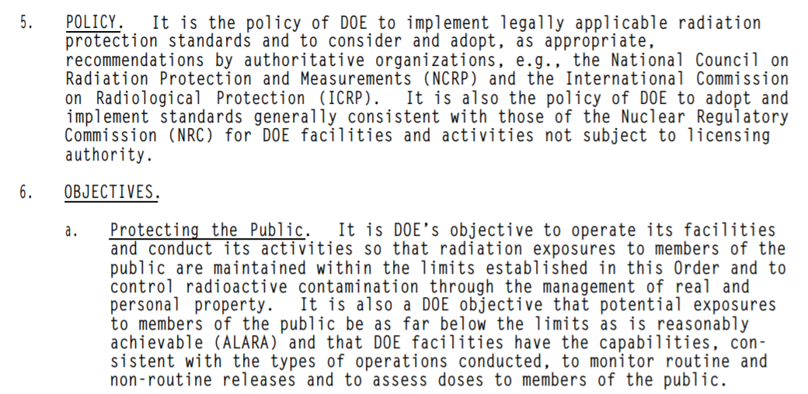
DOE Order 5400.5 Radiation Protection of the Public and the Environment

Slide 23

DOE-EM Site Clean-up Activities
As of January 2009, DOE-EM managed:
14 construction projects and 32 cleanup projects, many of which will require more than a decade to complete
Costing more than $6 billion a year for the previous 10 years and for the next 30 years
With total (2009) estimated costs exceeding $260 billion for these and 90 other remaining site remediations

Slide 24
These costs do not include…
Compliance in mining and milling of uranium, to fuel fabrication
Commercial nuclear power plant operations
Discontinued nuclear power plant decommissioning
Compliance with the permanent disposal of spent nuclear fuel
Remediation of other commercial nuclear sites not already the responsibility of the Department of Energy
Ongoing regulatory oversight by local, state, and the federal government
Other costs outside the geographical U.S.

Slide 25
Costs are driven by the public dose limit
According to the U.S. Environmental Protection Agency:
Cleanup regulations benefit society by reducing potential adverse health effects
These benefits justify the costs of cleanup
Costs are driven by the public dose limit
But it is not possible to accurately estimate the radiogenic health effects either before or after site remediation
EPA Radiation Site Cleanup Regulations, EPA-402-R-96-011A, 1994

Slide 26
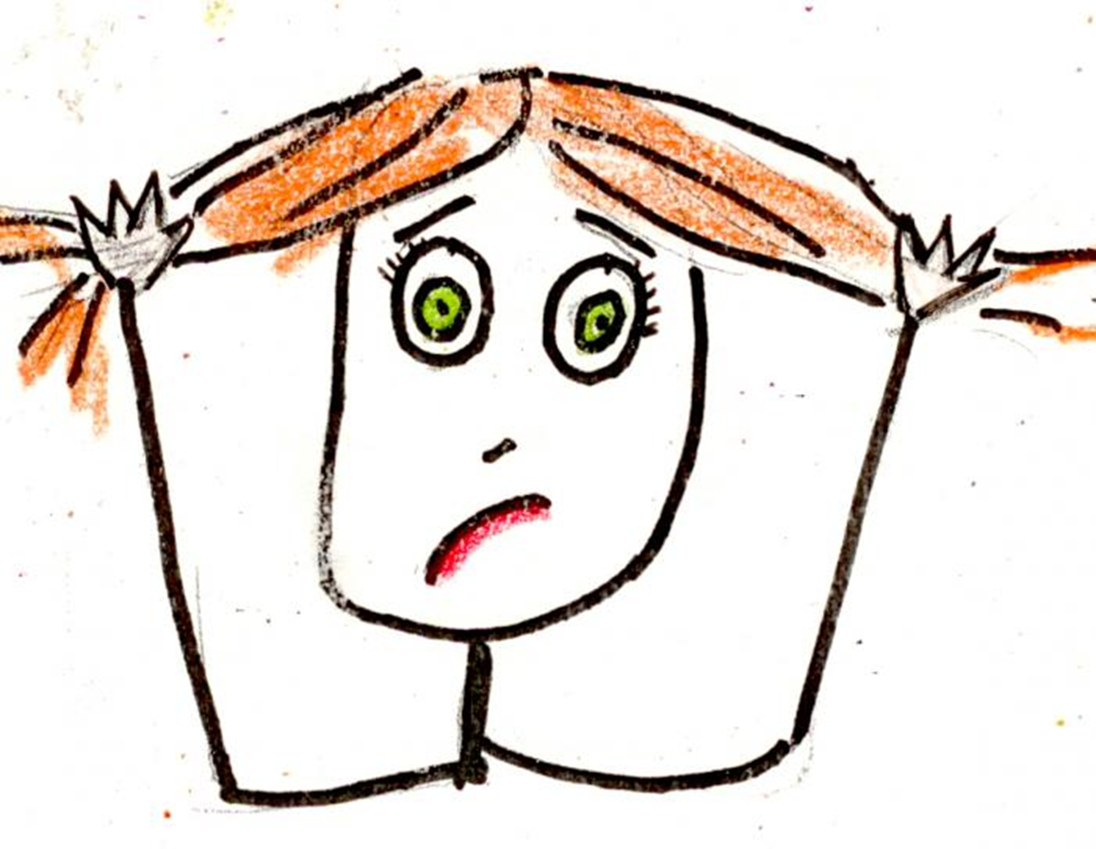
What to do?

Slide 27
Possible Solutions?
Revert back to the 1977 ICRP-26 dose limit for the general public of 5 mSv/year
Set the public dose limit at 20 mSv/year, referenced in ICRP Publication 103, para. 240, pages 96-97 and Table 5 (2007), where a public dose in “the second band, greater than 1 mSv but not more than 20 mSv, applies in circumstances where individuals receive direct benefits* from an exposure situation.”
* Electricity from nuclear energy, production of medical isotopes, national defense from military weapons production, restoration of a formerly contaminated site, etc.

Slide 28
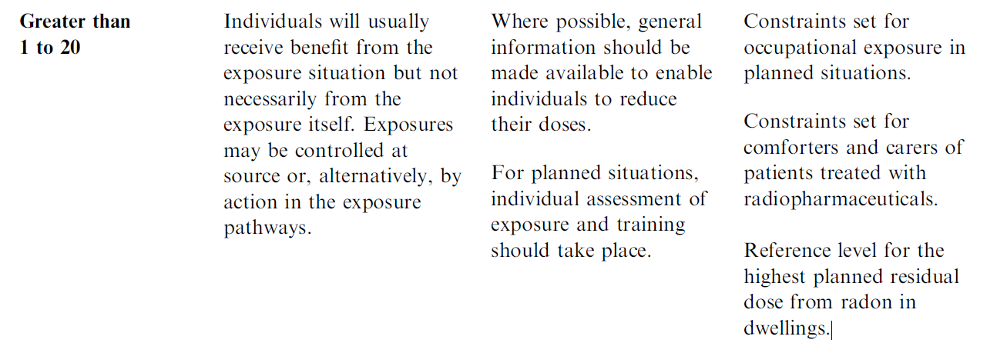
ICRP-103, 2007 The “second band”
From ICRP Publication 103, para. 240, pages 96-97 in Table 5 (2007)

Slide 29
Validation of Concept?
Indeed, in 10 CFR 20.1301, the Nuclear Regulatory Commission acknowledges the practicality of a 5 mSv public dose limit for:
Nuclear medicine patient release
Exemption situations where a licensee demonstrates the need
Furthermore, under 10 CFR 20.1208, the dose equivalent to an embryo/fetus during the entire pregnancy, due to occupational exposure of a declared pregnant woman, shall not exceed 0.5 rem (5 mSv).

Slide 30
Conclusions
The ICRP has set the public dose limit too low at 1 mSv/year
Science does not support the need for a public dose limit below 5 mSv/year, either on the basis of epidemiology or radiation biology
The high cost of regulatory compliance to tax-payers (citizens) and commercial entities is prohibitive--and likely unnecessary in terms of net gains in health and safety (cancer avoidance)
With high assurance, it seems reasonable that members of the public, including the unborn embryo/fetus, may be adequately protected with a public dose limit of 5 to 20 mSv per year

Slide 31
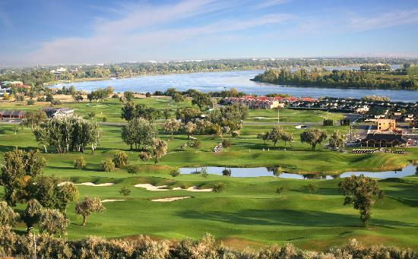
Thank you for your attention!

